Slide 1
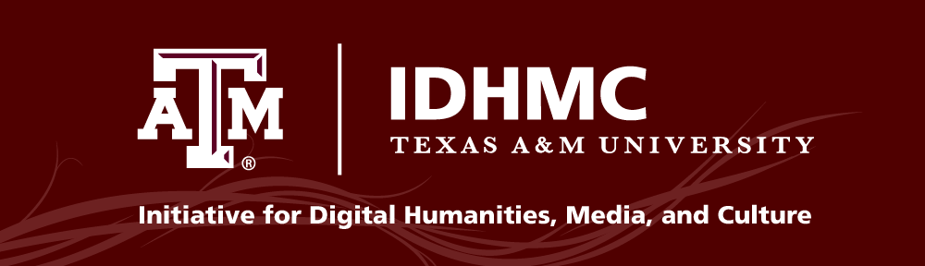
#MyDHis:
engaging emerging (digital) humanities paradigms via (disruptive) (alternative) collaboration
Liz Grumbach
@EMGrumbach
Presentation slides and script available at:
bit.ly/p4h-grumbach
Notes:
So I had the opportunity to talk about what #mydhis a bit at the Digital Humanities Summer Institute this year, and I wanted to give a version of that talk today for this group. As an alternate academic professional at TAMU and the IDHMC, I’ve had the pleasure of working as a project manager on two projects. So while my job includes a few more things, two specific projects really formed my understanding of what DH is and/or should be.
At the core of what I want to talk about today is the way the work DH does and the work we’ve been discussing this past month can disrupt or remodel or modify our perceptions of how and where scholarly research is produced in our disciplines. And how it can change the way we conceptualize scholarly communication.

Slide 2
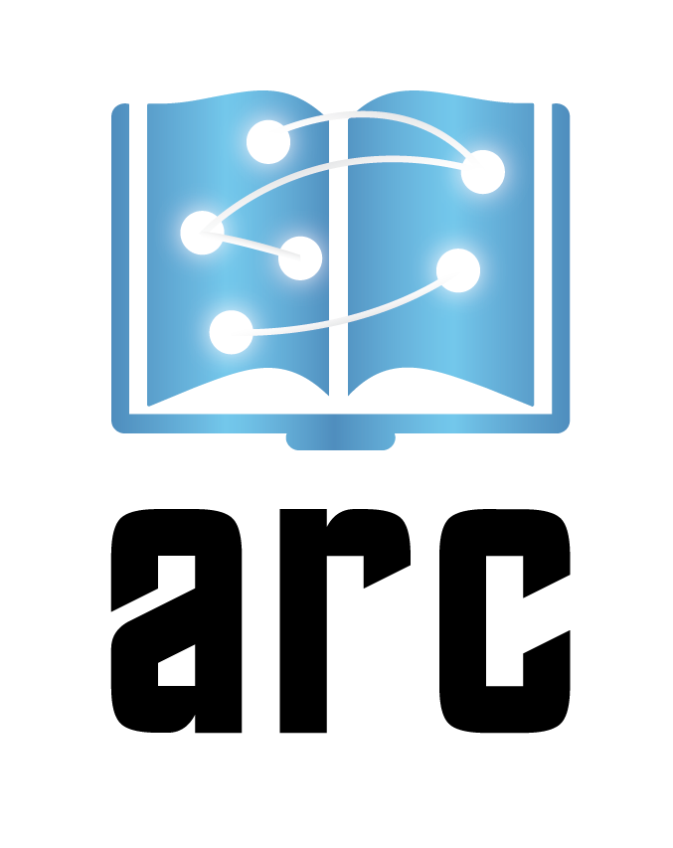
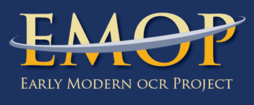
ar-c.org
emop.tamu.edu
Liz Grumbach @EMGrumbach
Notes:
Over the course of this course, Laura Mandell has given wise and beautiful rundowns of two IDHMC signature projects: the Advanced Research Consortium (ARC) and the Early Modern OCR Project (eMOP).
I’ve had the pleasure of serving as project manager on these two projects, and the experience has made me realize that #myDHis about collaboration, and I’m interested in interrogating what that means for the future of scholarly communication in the humanities.

Slide 3
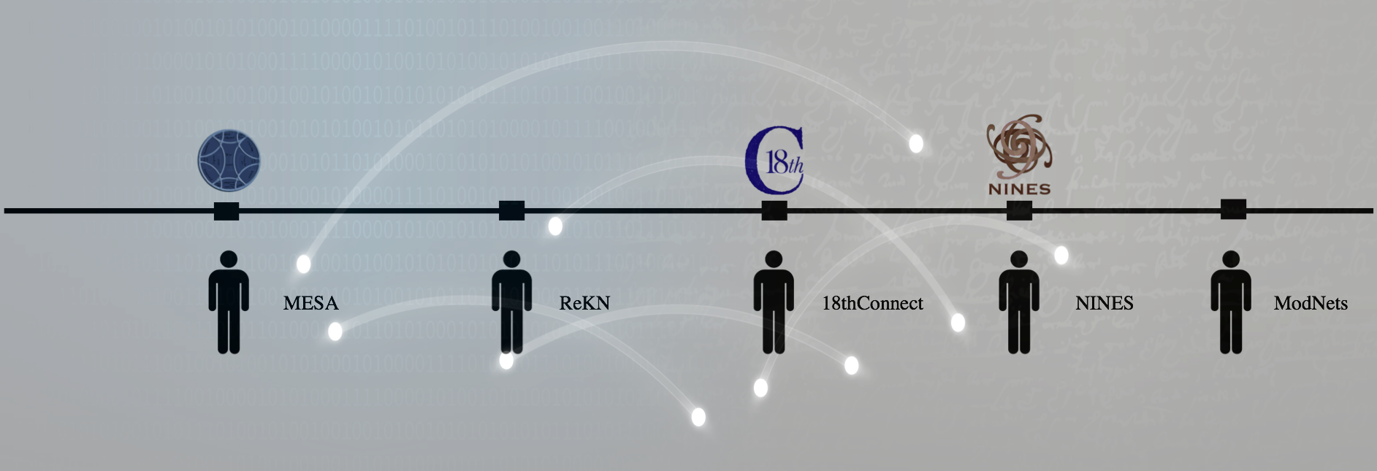

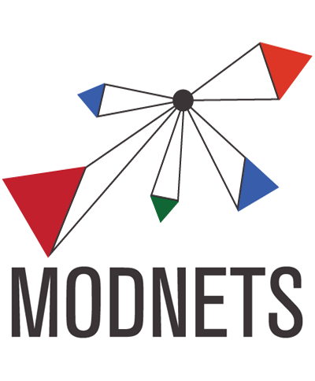
Liz Grumbach @EMGrumbach
Notes:
We like to say at the ARC offices that we’re an organization created by scholars, for scholars. ARC oversees, supports, and sustains several virtual research environments for humanists. And it’s important to note that each of these communities are managed by faculty, staff, and librarians from multiple disciplines and multiple institutions.

Slide 4
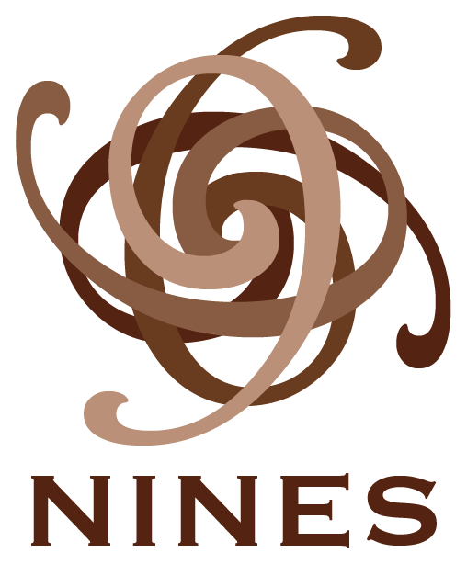
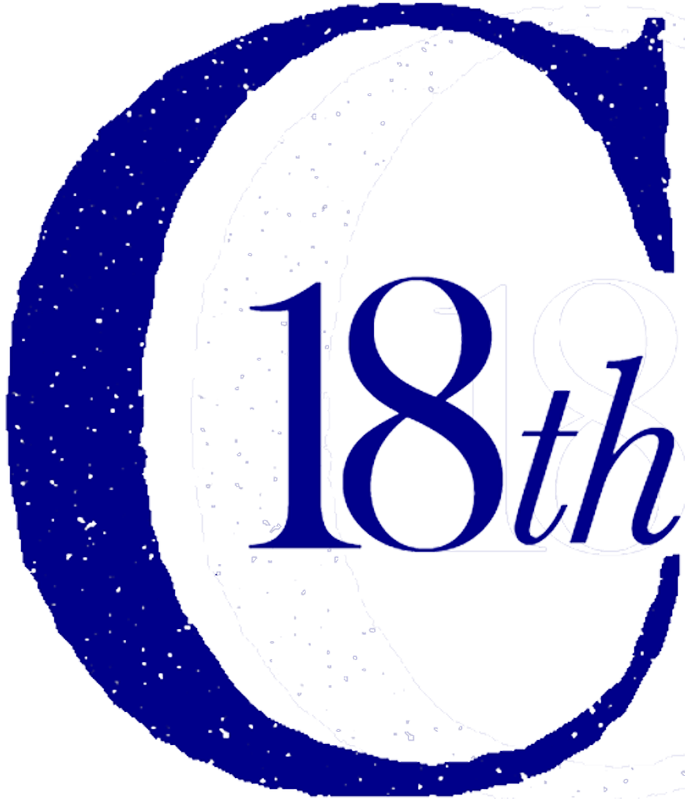
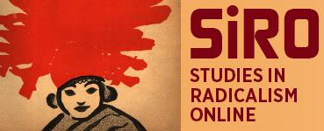
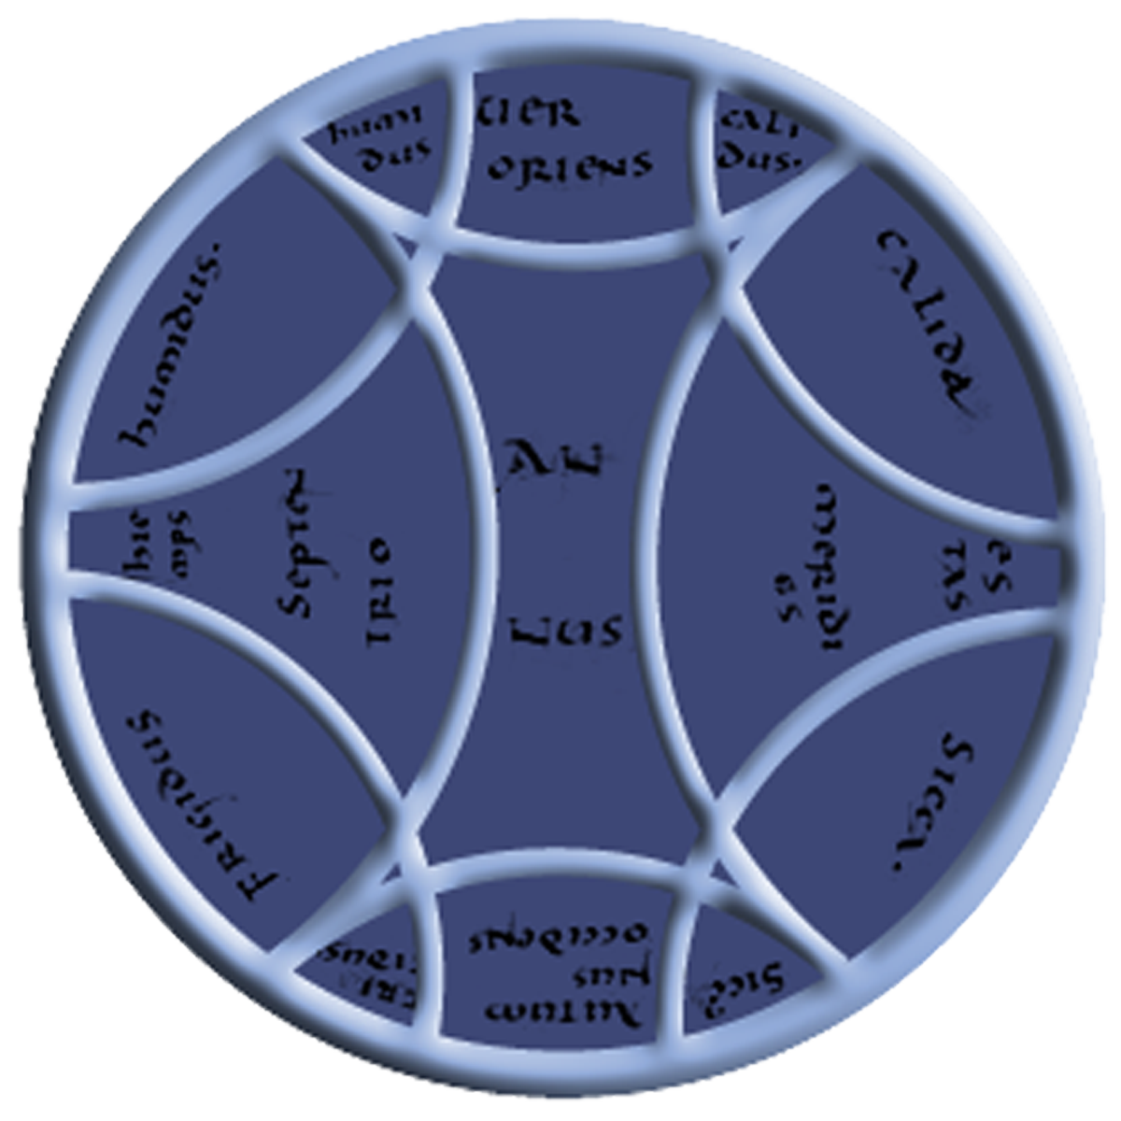

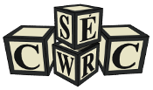
ARC: By Scholars, For Scholars
Liz Grumbach @EMGrumbach
Notes:
Over the past few years, I’ve seen the ARC organization grow from three communities to all those pictured here and more. As we redefine what it means to be part of ARC, we’re also ever adapting to meet the needs of a diverse range of scholarly communities. We provide the services of digital aggregation and peer review, but our ultimate goal is to continue to serve and support the creation and legitimization of digital scholarship.

Slide 5
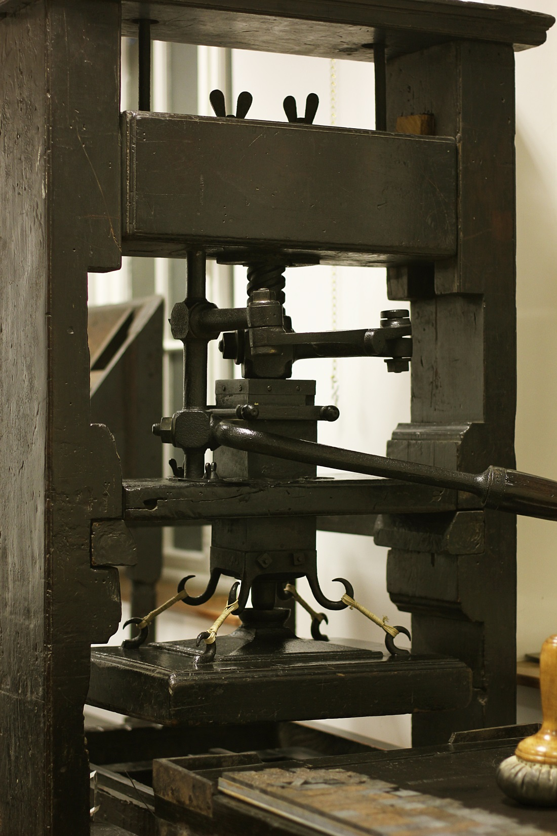
emop.tamu.edu
Picture by Dr. Todd Samuelson
St. Bride Library, 2014
Liz Grumbach @EMGrumbach
Notes:
By now, I think most people in this course are familiar with eMOP, so I won’t go into much detail. But to me, at the heart of the early modern OCR project was the question: if we apply book history expertise to the specific technological problem that is ”bad” historical OCR, can we come up with reusable and open source solutions to share with the community?
eMOP’s goal was to improve the visibility of early modern texts by making their contents fully searchable.
Digitization of these texts are important, but it is also important to structure data, texts, and words so that they are findable – otherwise researchers won’t know that they exist. The archive needs to be technologically structured in a way that allows discovery, but also allows humanists to discover what they need.

Slide 6


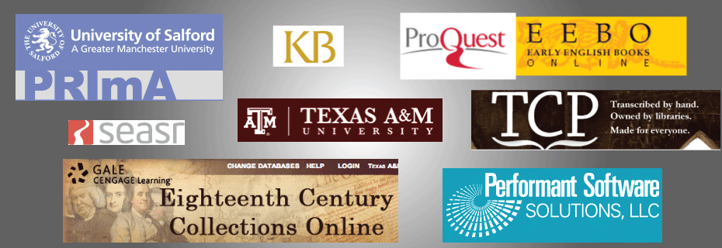
emop.tamu.edu
Liz Grumbach @EMGrumbach
Notes:
And that interdisciplinary question required interdisciplinary collaboration.
Our partners on the initial eMOP grant, funded by the Andrew W Mellon Foundation, were intentionally interdisciplinary and international. We wanted to tap into, or create, a community of scholars interested in solving the historical OCR problem.
And while the initial grant term is over, the eMOP team is continuing to partner with collaborators to expand our workflows and refine our tools.

Slide 7
ar-c.org
emop.tamu.edu
#MyDHis modding the academy
#MyDHis all about the collabs
Liz Grumbach @EMGrumbach
Notes:
With those very brief project descriptions in mind, I have a few questions that I’ve been asking myself the past few years:
How and where is scholarly research produced now? - is it changing?
Are we modding the academy with new players and characters like: collaboration, interdisciplinary, open access materials, open source tools?
Are we ramping up the engine of academia by modifying the way that scholars produce content?
At DHSI this year, I proposed that DH is revealing, changing, or modding a pervasive myth of scholarship and scholarly communication that we’ve relied on for decades. We have the tools of collaboration and interdisciplinary, and actual digital tools created by our peers, that allow us to collapse, interrogate, and modify our perceptions of work, labor, and credit in a scholarly context.
#myDHis about modifying the academic myth of how knowledge should be produced and should be shared in the humanities.

Slide 8


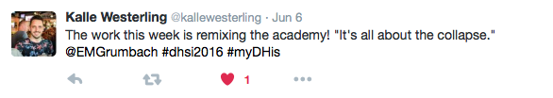

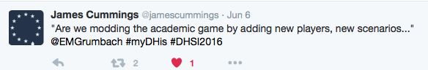
Notes:
And I’d just like to take a moment to thank all of my peers on Twitter (not just those pictured) for helping me form the second version of this talk.
(Thank you all, as well!)

